Slide 1
Lecture 2: background subtraction and Tracking
Instructor: Jianfeng(Jeff) Ren
Qualcomm Inc

Slide 2
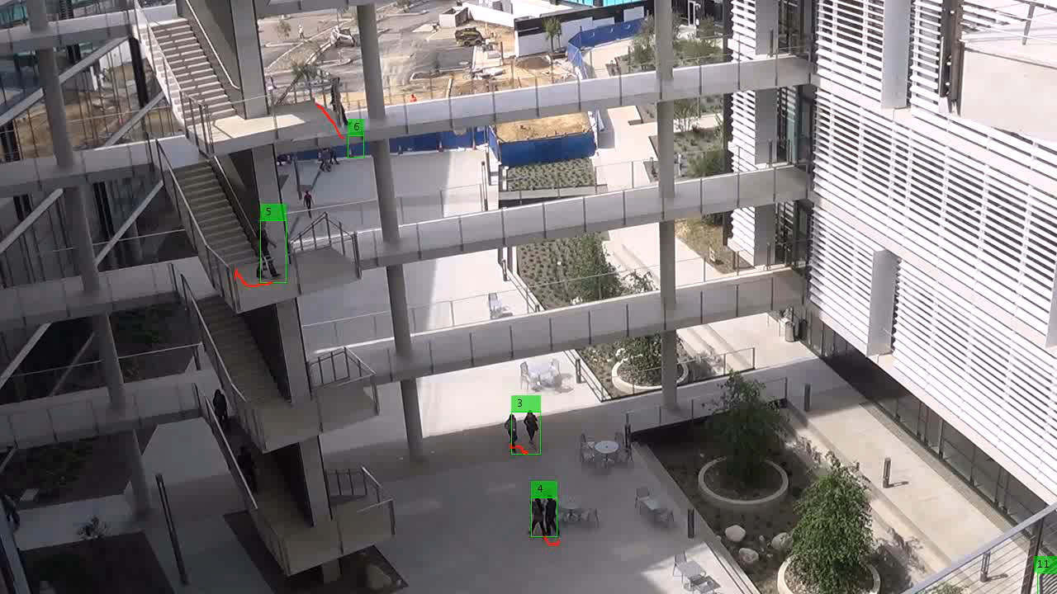
Surveillance Tracking algorithm
Background subtraction
(Mixture of Gaussian Model)
Blob Analysis to detect the foreground object
Foreground object Tracking

Slide 3
Applications for background substraction
Track monitoring (counting vehicles, detecting & tracking vehicles),
Human action recognition (run, walk, jump, squat, : : :),
Human-computer interaction (human interface"),
Object tracking (watched tennis lately?!?),

Slide 5
Frame differencing

Slide 6
Mean Filter

Slide 7
Median Filter

Slide 8
Adaptive background Mixture Model

Slide 9
Algorithm Flow

Slide 10
OpenCV code for background subtraction(1)

Slide 11
OpenCV code for background subtraction (2)

Slide 12
Homework Assignment
Read one video you taken from your mobile phone;
Trying to use the mean filter for background subtraction;
See how about the performance compared with mixture Gaussian model approach;
Can you improve the tracking part??

Slide 13
https://github.com/jxr041100/OpenCV_UCSD_WORKSHOP
OpenCV installation on your computer.

